Slide 1
Audio Amplifier Project
Under the supervesion of Dr. Said Emam and Eng. Engy George

Slide 2
Prepared by:
Hazem Abuelanin Mohamed
Lujain Ahmed Youssef
Mohamed Hany Mohamed
Nour Hesham Elsayed
Raneem Ahmed Refaat

Slide 3
Introduction
The goal of audio amplifiers is to reproduce input audio signals at sound-producing output elements, with desired volume and power levels faithfully, efficiently, and at low distortion.
There are various usages of audio amplifiers. Some of them are listed as follows
In the sound systems, these amplifiers are most widely used.
In various instruments that relate to music, these amplifiers are installed.

Slide 4
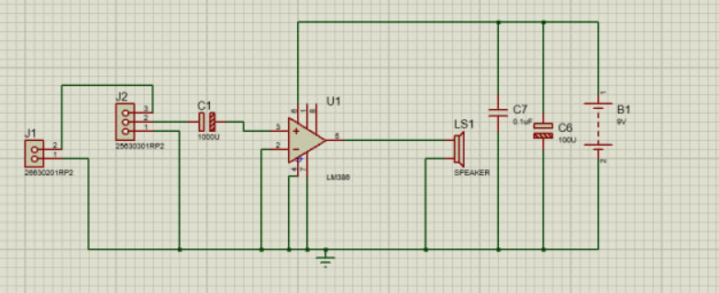
First Design
The circuit worked inefficiently and the sound was impure, distorted and there was high percentage of noise.

Slide 5
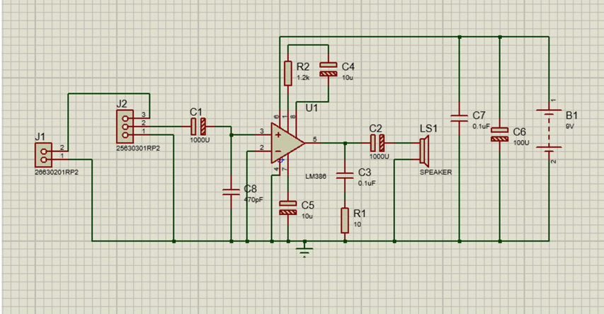
Final Design
The circuit operated well with sharp, high and clear sound.

Slide 6
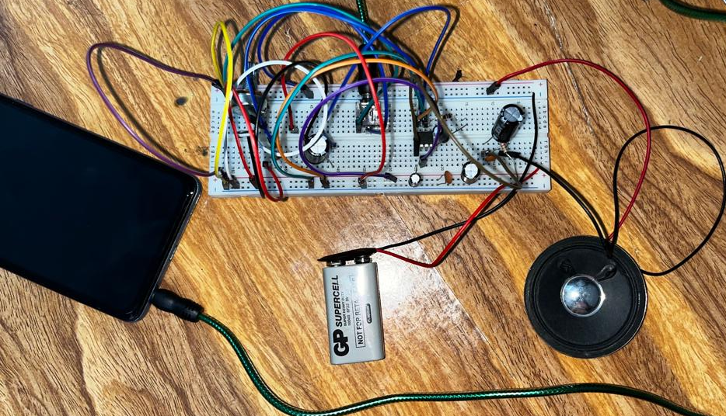
Breadboard
Implementing the circuit and testing it.

Slide 7
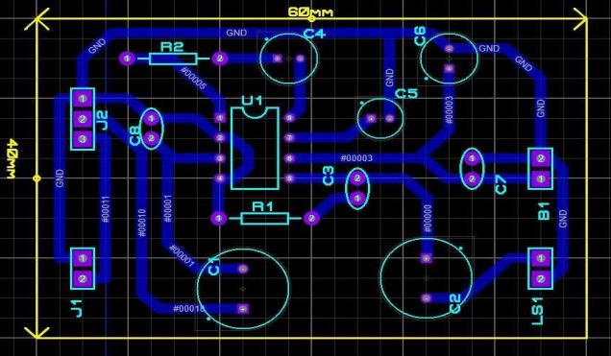
PCB Layout
Making the routes organized and the circuit compact.

Slide 8
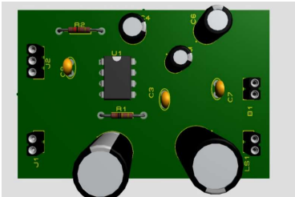
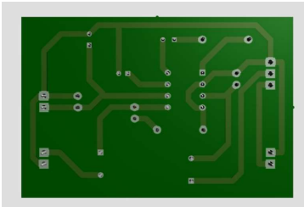
3D simulation of PCB

Slide 9
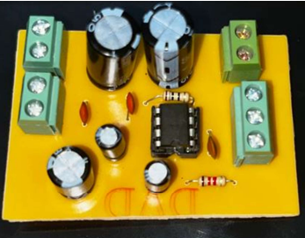
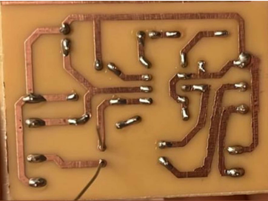
In Real Life PCB
Installing the components.

Slide 10
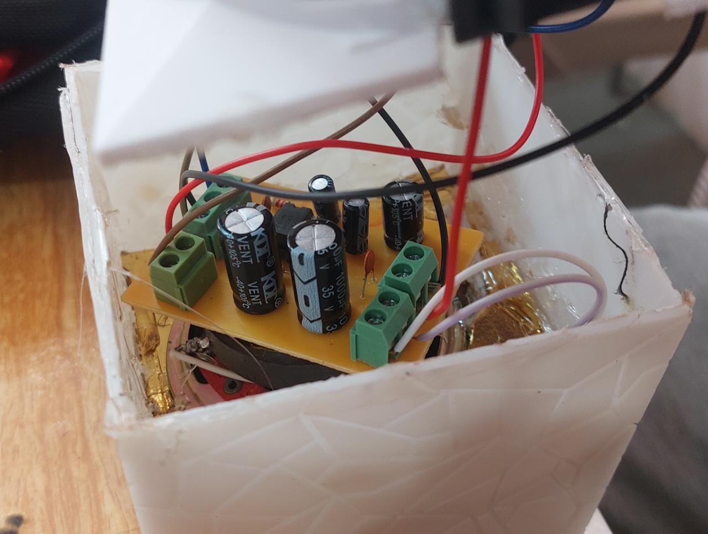
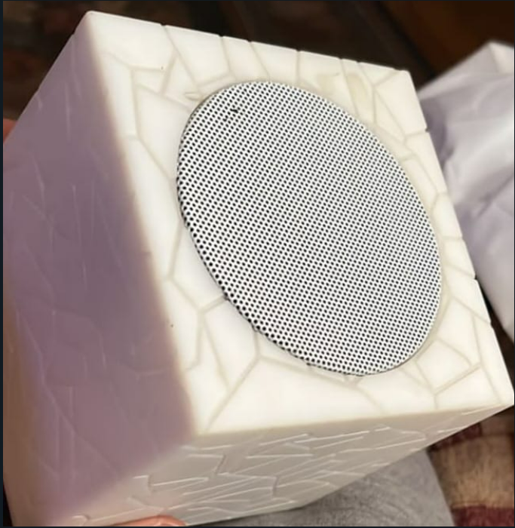
Final shape
Putting the audio amplifier inside the box to make it look better and function better.

Slide 11
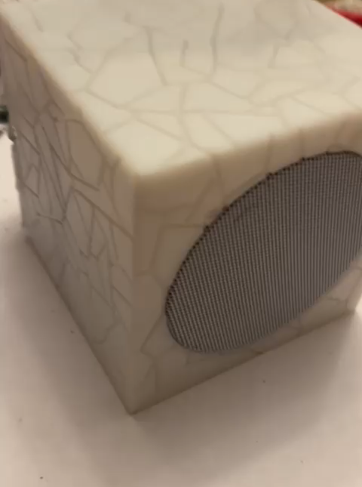

Slide 12
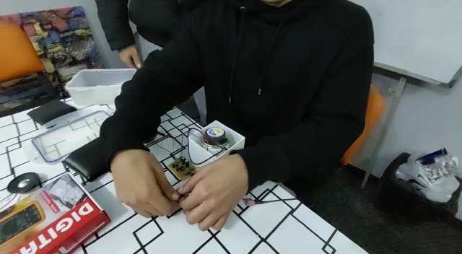

Slide 13

Thank You!

